Slide 1
Facial Expression Recognition
Ying shen
School of software engineering
Sse, tongji university

Slide 2
Outline
Introduction
Facial expression recognition
Appearance-based vs. model based
Active appearance model (AAM)
Pre-requisite
Principle component analysis (PCA)
Procrustes analysis
ASM
Delaunay triangulation
AAM

Slide 3
Outline
Introduction
Facial expression recognition
Appearance-based vs. model based
Active appearance model (AAM)
Pre-requisite
Principle component analysis (PCA)
Procrustes analysis
ASM
Delaunay triangulation
AAM

Slide 4
Introduction
Smile dection

Slide 5






Introduction
Facial expression recognition

Slide 6
Introduction
Facial expression recognition
Happy: 83%
Disgusted: 9%
Fearful: 6%
Angry: 2%

Slide 7
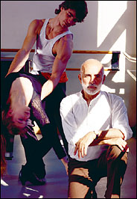
Introduction
Factors affect facial expression recognition accuracy
Pose
Illumination
...

Slide 8
Outline
Introduction
Facial expression recognition
Appearance-based vs. model based
Active appearance model (AAM)
Pre-requisite
Principle component analysis (PCA)
Procrustes analysis
ASM
Delaunay triangulation
AAM

Slide 9
Facial expression recognition
Framework of automatic facial expression recognition

Slide 10
Facial expression recognition
Appearance-based methods
E.g. Features are extracted using Garborfilter

Slide 11
Facial expression recognition
CMU facial expression database (CK, CK+ database)
8000+ images
Six basic expressions
Training preparation
create positive examples
prepare negative examples
Training
Train Haar-like features using OpenCV
Or train a NN classifier using extracted features

Slide 12
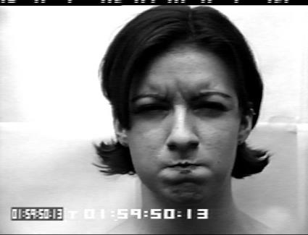
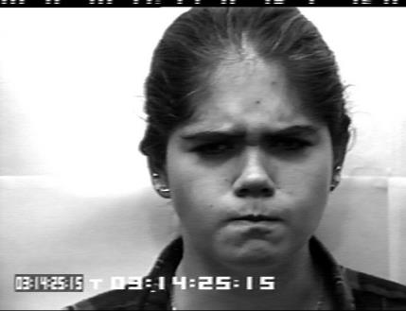
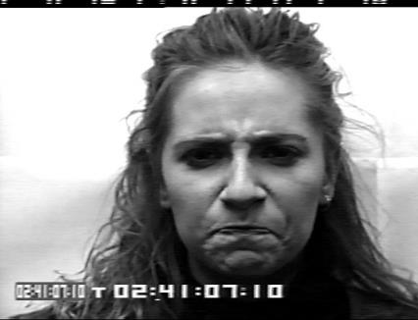
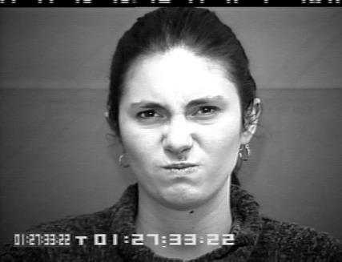
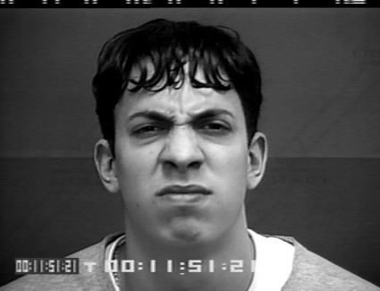
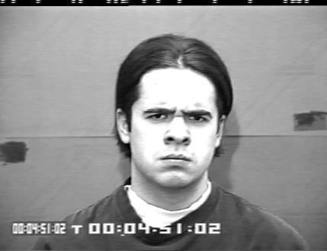
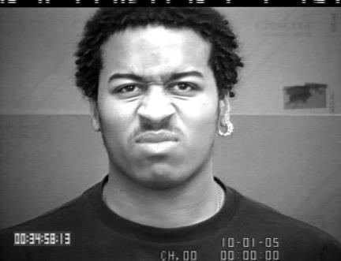
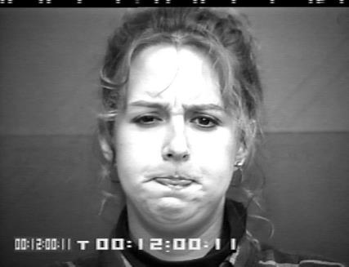
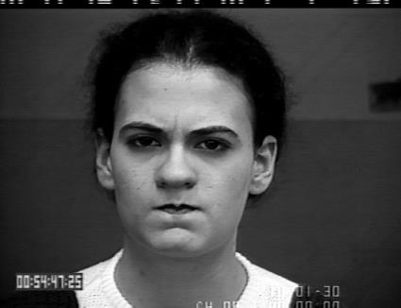
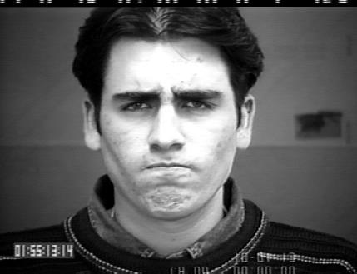
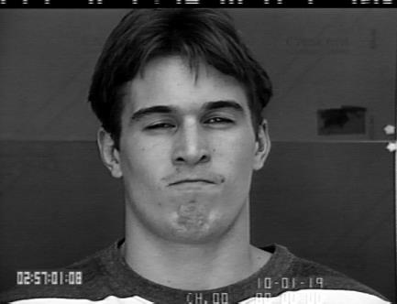
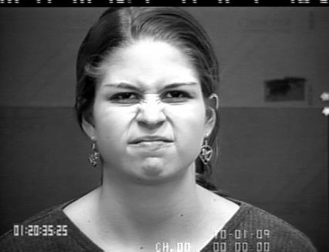
Facial expression recognition
Angry Positive Examples for Training

Slide 13
Facial expression recognition
Model-based methods

Slide 14
Outline
Introduction
Facial expression recognition
Appearance-based vs. model based
Active appearance model (AAM)
Pre-requisite
Principle component analysis (PCA)
Procrustes analysis
ASM
Delaunay triangulation
AAM

Slide 15
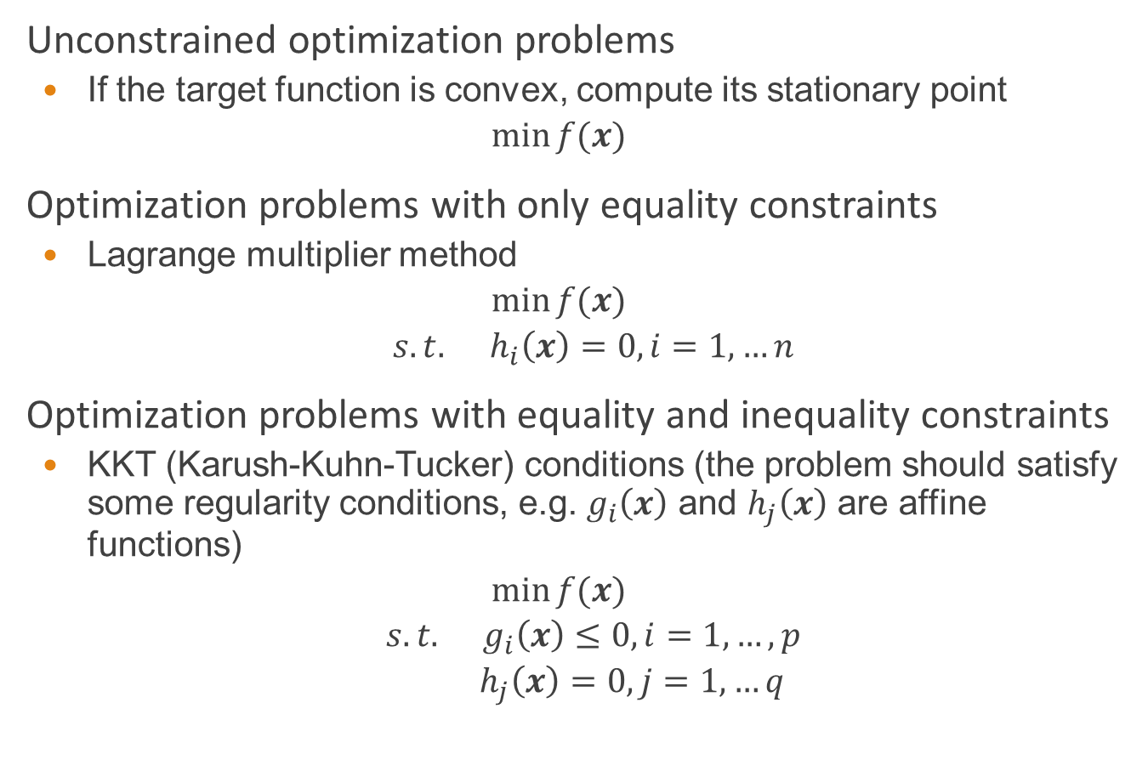
Pre-requisite: Optimization problems
Unconstrained optimization problems
If the target function is convex, compute its stationary point
$$\min{f(x)}$$
Optimization problems with only equality constraints
Lagrange multiplier method
$$\min{f(x)}$$
$$s.t. h_{i}\left(x\right)=0, i=1,…n$$
Optimization problems with equality and inequality constraints
KKT (Karush-Kuhn-Tucker) conditions (the problem should satisfy some regularity conditions, e.g. $g_{i}\left(x\right)$ and $h_{j}\left(x\right)$ are affine functions)
$$\min{f(x)}$$
$$s.t. g_{i}\left(x\right)≤0, i=1,…,p$$
$$h_{j}\left(x\right)=0, j=1,…q$$

Slide 16
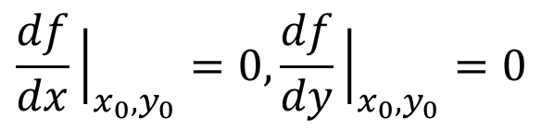
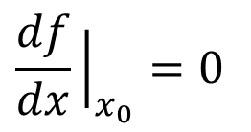
Unconstrained optimization problems
A stationary point of a differentiable function of one variable is a point of the domain of the function where the derivative is zero
Single-variable function:
f(x) is differentiable in (a, b). At x₀,
Two-variables function:
f(x, y) is differentiable in its domain. At (x₀, y₀),
$$\frac{df}{dx}{\left.​\right|}_{x_{0}}=0$$
$$\frac{df}{dx}{\left.​\right|}_{x_{0},y_{0}}=0,\frac{df}{dy}{\left.​\right|}_{x_{0},y_{0}}=0$$

Slide 17
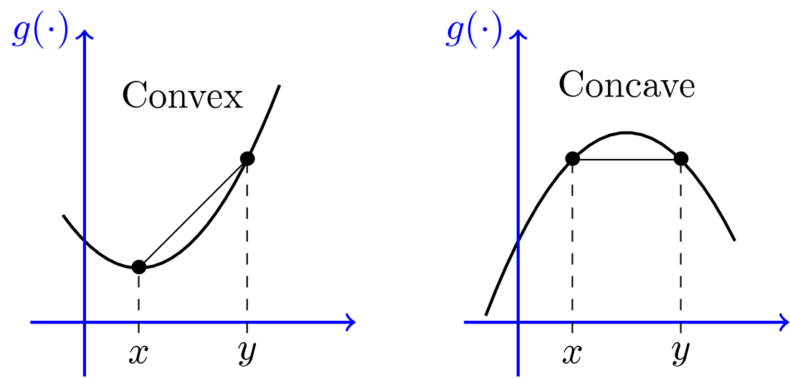
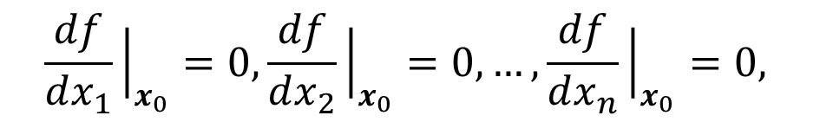
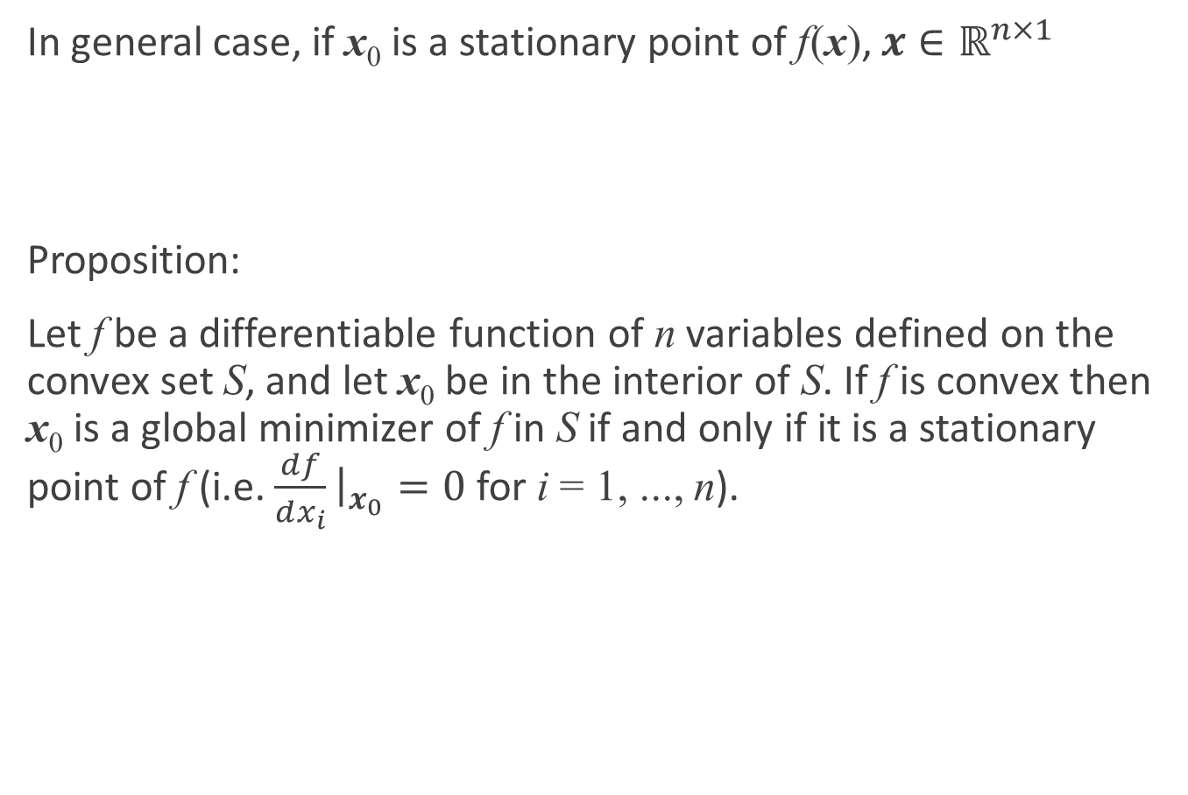
Unconstrained optimization problems
In general case, if x₀ is a stationary point of f(x), $x∈ℝ^{n×1}$
Proposition:
Let f be a differentiable function of n variables defined on the convex set S, and let x₀ be in the interior of S. If f is convex then x₀ is a global minimizer of f in S if and only if it is a stationary point of f (i.e. $\frac{df}{dx_{i}}{\left.​\right|}_{x_{0}}=0$ for i = 1, ..., n).
$$\frac{df}{dx_{1}}{\left.​\right|}_{x_{0}}=0,\frac{df}{dx_{2}}{\left.​\right|}_{x_{0}}=0,…,\frac{df}{dx_{n}}{\left.​\right|}_{x_{0}}=0,$$

Slide 18
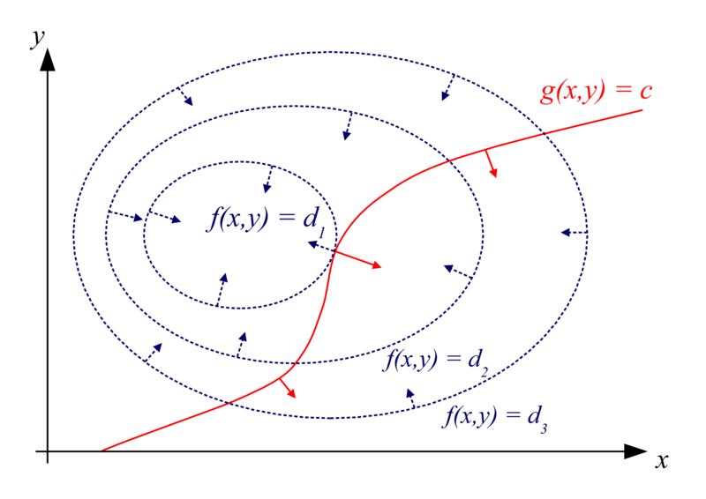
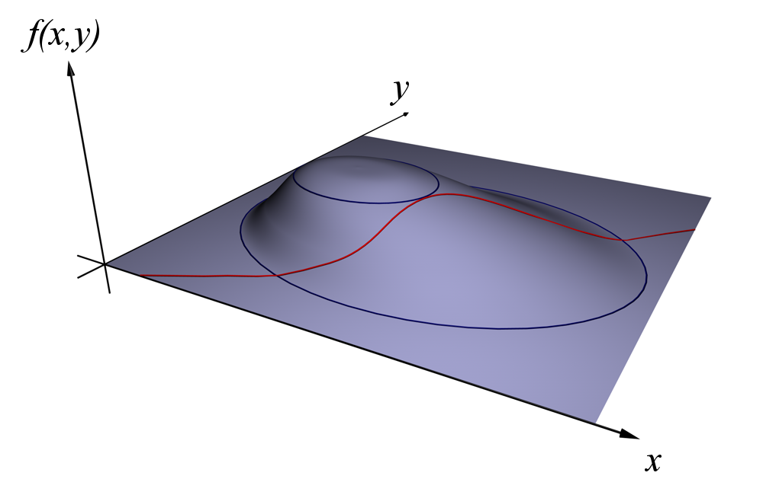
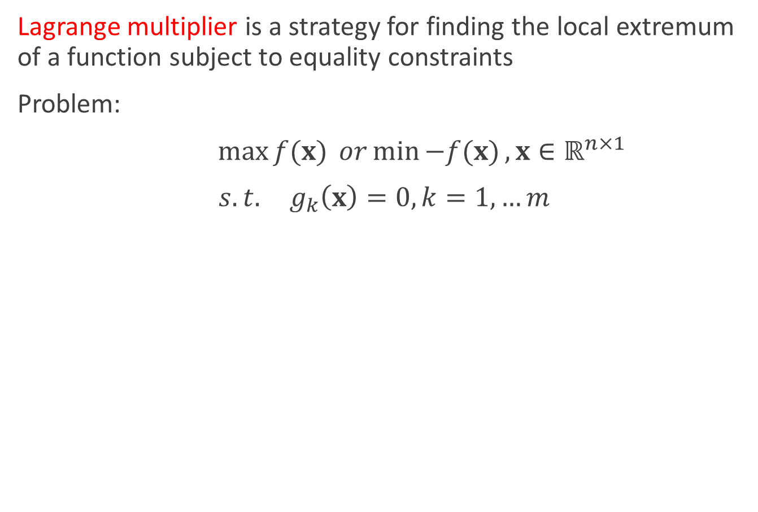
Optimization problems with equality constraints
Lagrange multiplier is a strategy for finding the local extremum of a function subject to equality constraints
Problem:
$\max{f(x)} or\min{−f(x)},x∈ℝ^{n×1}$
$s.t. g_{k}\left(x\right)=0, k=1,…m$

Slide 19
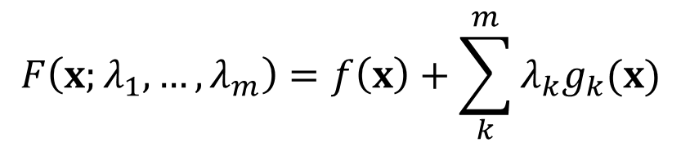
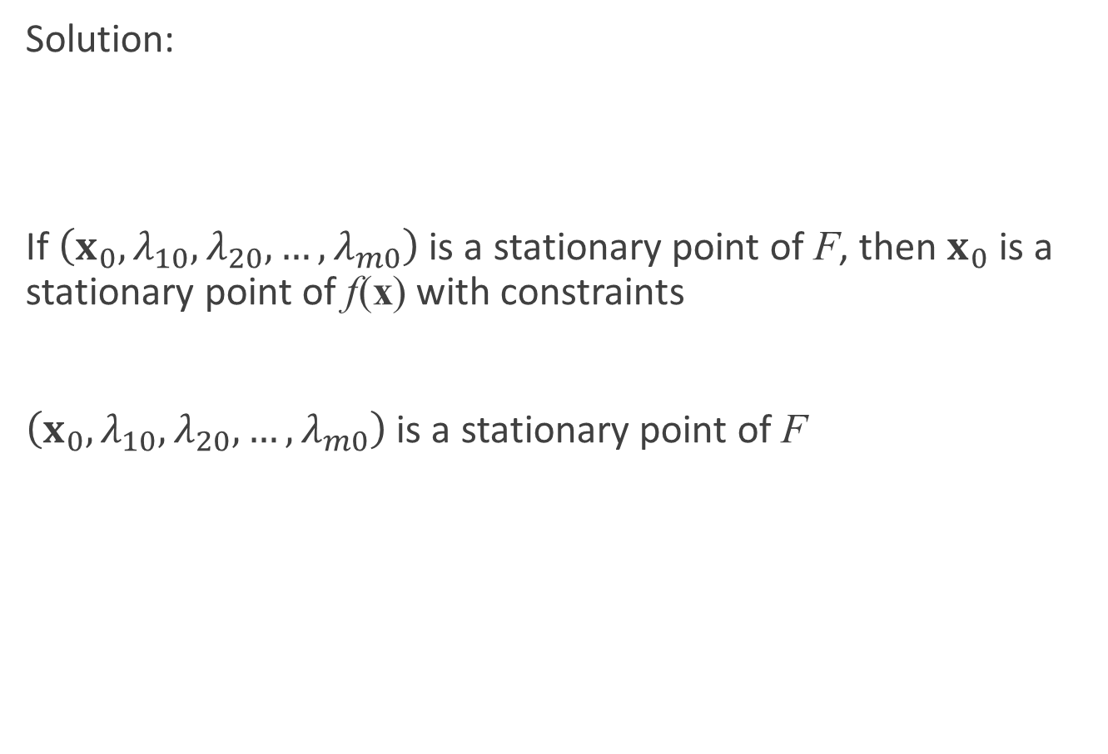
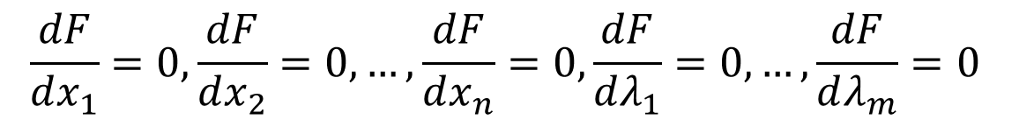
Optimization problems with equality constraints
Solution:
If $\left(x_{0},λ_{10},λ_{20},…,λ_{m0}\right)$ is a stationary point of F, then $x_{0}$ is a stationary point of f(x) with constraints
$\left(x_{0},λ_{10},λ_{20},…,λ_{m0}\right)$ is a stationary point of F
$$F\left(x;λ_{1},…,λ_{m}\right)=f\left(x\right)+\sum_{k}^{m}{λ_{k}g_{k}(x)}$$
$$\frac{dF}{dx_{1}}=0, \frac{dF}{dx_{2}}=0,…,\frac{dF}{dx_{n}}=0,\frac{dF}{dλ_{1}}=0,…,\frac{dF}{dλ_{m}}=0$$
n+m equations!

Slide 20
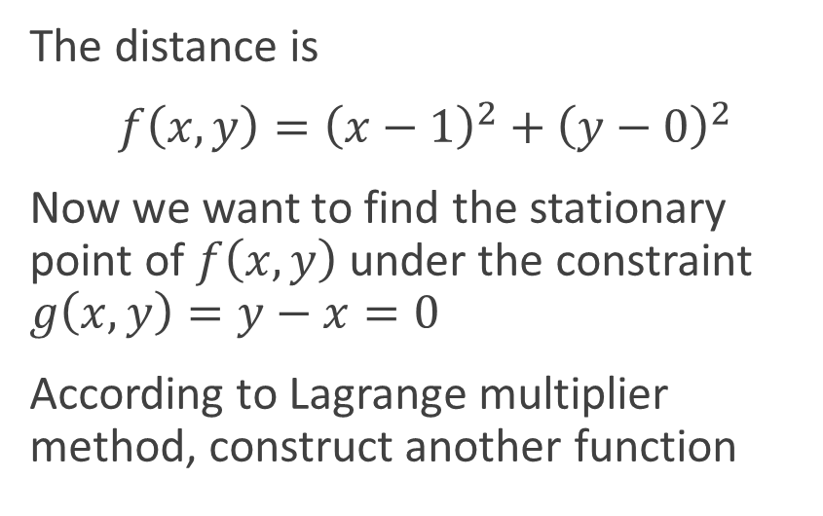

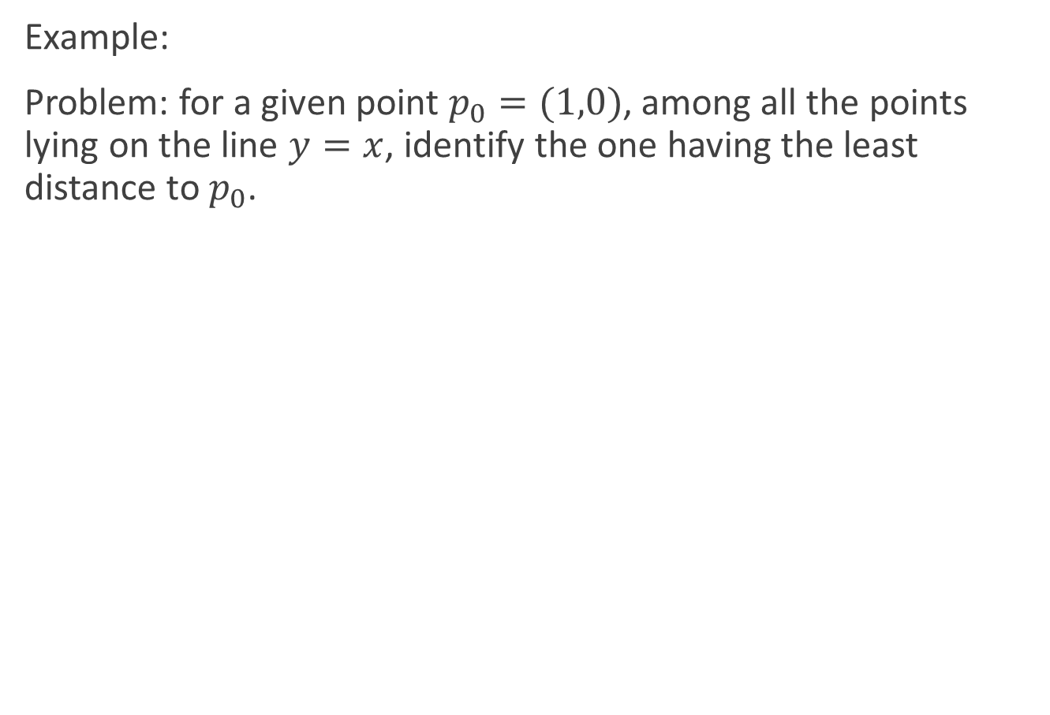
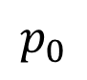
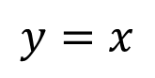
Optimization problems with equality constraints
Example:
Problem: for a given point $p_{0}=(1,0)$, among all the points lying on the line $y=x$, identify the one having the least distance to $p_{0}$.
The distance is
$f\left(x,y\right)={\left(x−1\right)}^{2}+{\left(y−0\right)}^{2}$
Now we want to find the stationary point of $f\left(x,y\right)$ under the constraint $g\left(x,y\right)=y−x=0$
According to Lagrange multiplier method, construct another function
$$?$$
$$p_{0}$$
$$y=x$$
$$F\left(x,y,λ\right)=f\left(x,y\right)+λg\left(x,y\right)={\left(x−1\right)}^{2}+{\left(y−0\right)}^{2}+λ(y−x)$$

Slide 21
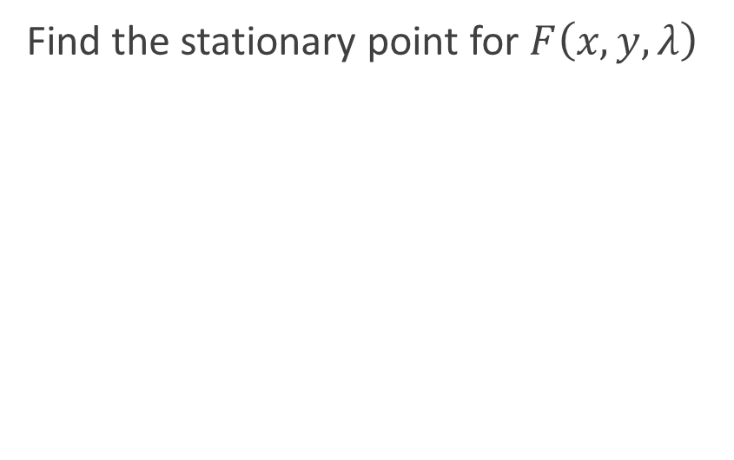
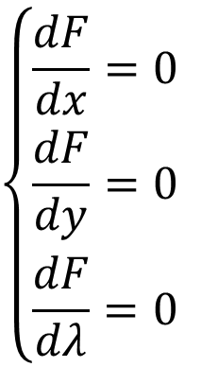
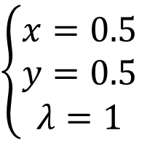
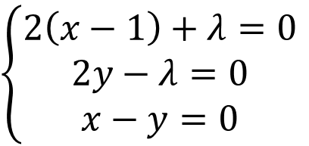
Optimization problems with equality constraints
Example:
Problem: for a given point $p_{0}=(1,0)$, among all the points lying on the line $y=x$, identify the one having the least distance to $p_{0}$.
Find the stationary point for $F\left(x,y,λ\right)$
$$\left\{\begin{aligned}\frac{dF}{dx}=0 \\ \frac{dF}{dy}=0 \\ \frac{dF}{dλ}=0 \end{aligned}\right.$$
$$?$$
$$\left\{\begin{aligned}2\left(x−1\right)+λ=0 \\ 2y−λ=0 \\ x−y=0\end{aligned}\right.$$
$$p_{0}$$
$$y=x$$
$$\left\{\begin{aligned}x=0.5 \\ y=0.5 \\ λ=1\end{aligned}\right.$$

Slide 22
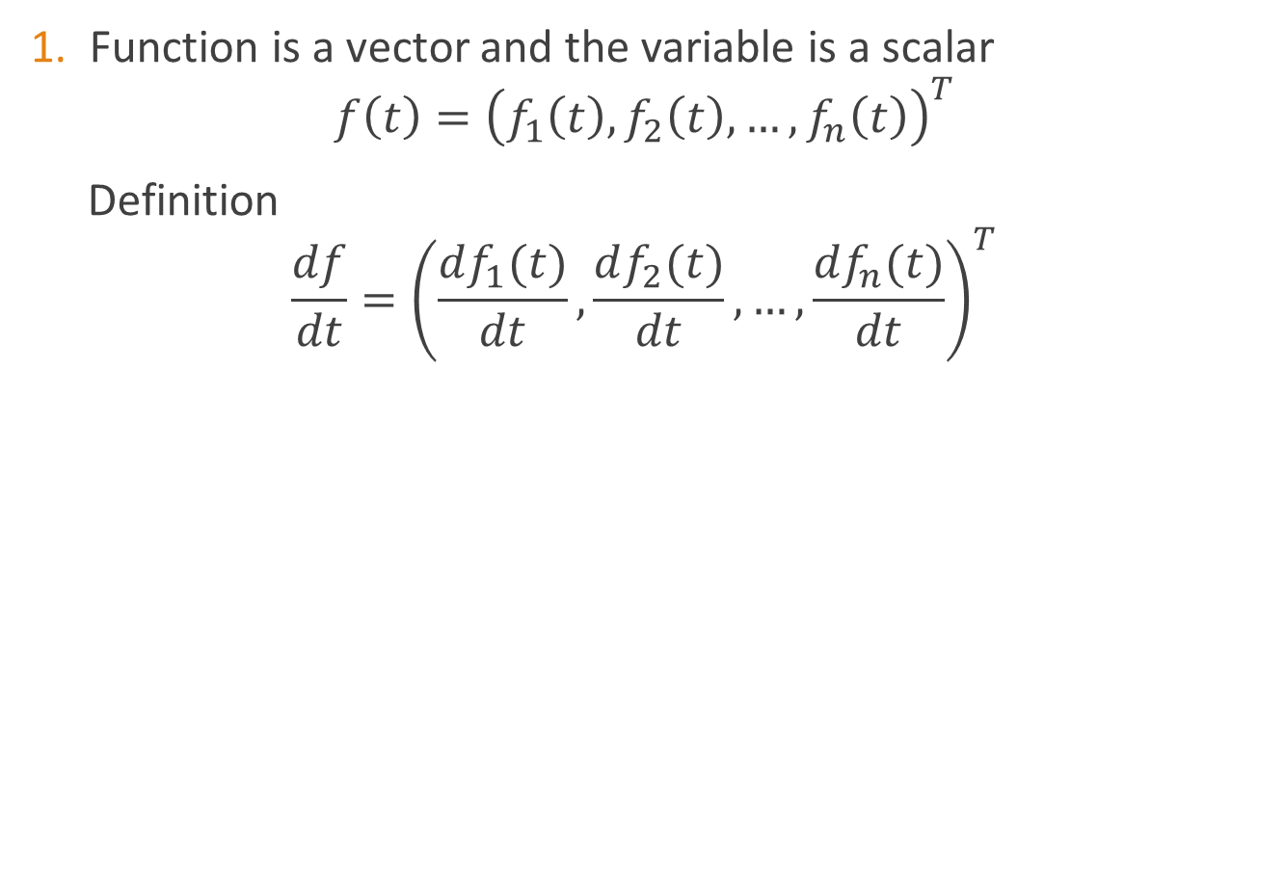
Pre-requisite: Matrix differentiation
Function is a vector and the variable is a scalar
$$f\left(t\right)={\left(f_{1}\left(t\right), f_{2}\left(t\right),…,f_{n}\left(t\right)\right)}^{T}$$
Definition
$$\frac{df}{dt}={\left(\frac{df_{1}(t)}{dt},\frac{df_{2}(t)}{dt},…,\frac{df_{n}(t)}{dt}\right)}^{T}$$

Slide 23
Pre-requisite: Matrix differentiation
Function is a matrix and the variable is a scalar
Definition

Slide 24
Pre-requisite: Matrix differentiation
Function is a scalar and the variable is a vector
Definition
In a similar way

Slide 25
Pre-requisite: Matrix differentiation
Function is a vector and the variable is a vector
Definition

Slide 26
Pre-requisite: Matrix differentiation
Function is a vector and the variable is a vector
In a similar way

Slide 27
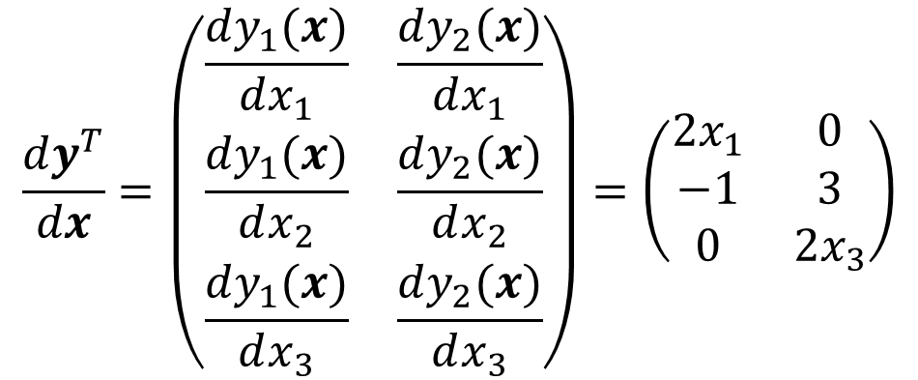
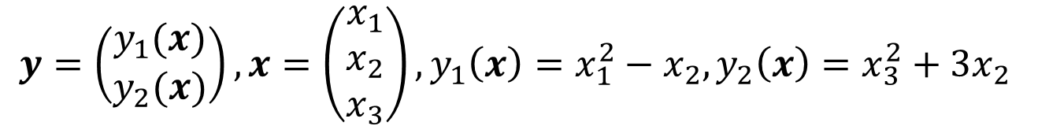
Pre-requisite: Matrix differentiation
Function is a vector and the variable is a vector
Example
$$y=\left(\begin{matrix}y_{1}(x) \\ y_{2}(x)\end{matrix}\right), x=\left(\begin{matrix}x_{1} \\ x_{2} \\ x_{3}\end{matrix}\right),y_{1}\left(x\right)=x_{1}^{2}−x_{2},y_{2}\left(x\right)=x_{3}^{2}+3x_{2}$$
$$\frac{dy^{T}}{dx}=\left(\begin{matrix}\frac{dy_{1}(x)}{dx_{1}} & \frac{dy_{2}(x)}{dx_{1}} \\ \frac{dy_{1}(x)}{dx_{2}} & \frac{dy_{2}(x)}{dx_{2}} \\ \frac{dy_{1}(x)}{dx_{3}} & \frac{dy_{2}(x)}{dx_{3}}\end{matrix}\right)=\left(\begin{matrix}2x_{1} & 0 \\ −1 & 3 \\ 0 & 2x_{3}\end{matrix}\right)$$

Slide 28
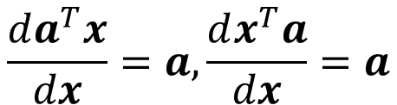
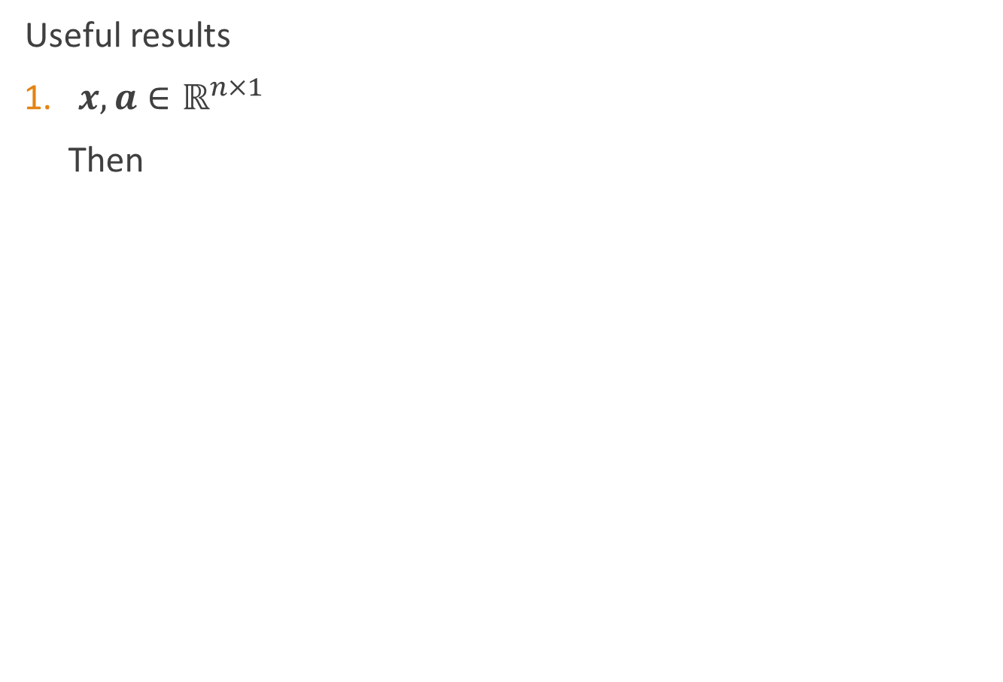
Pre-requisite: Matrix differentiation
Useful results
$x,a∈ℝ^{n×1}$
Then
$$\frac{da^{T}x}{dx}=a,\frac{dx^{T}a}{dx}=a$$

Slide 29
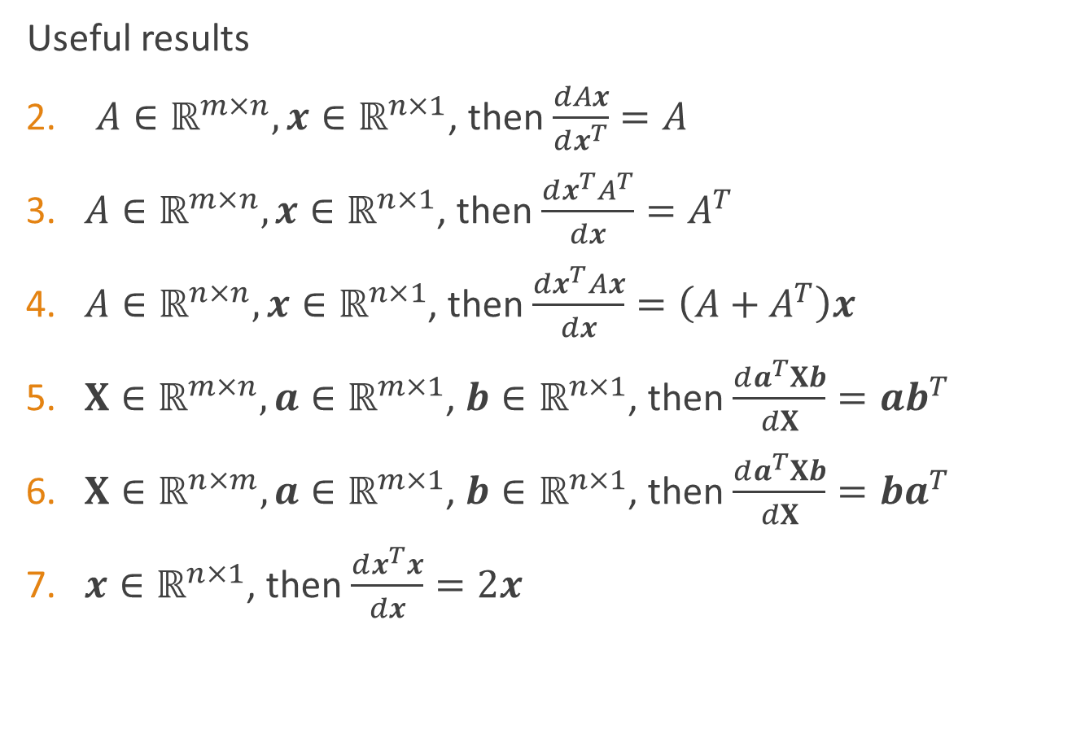
Pre-requisite: Matrix differentiation
Useful results
$A∈ℝ^{m×n},x∈ℝ^{n×1}$, then $\frac{dAx}{dx^{T}}=A$
$A∈ℝ^{m×n},x∈ℝ^{n×1}$, then $\frac{dx^{T}A^{T}}{dx}=A^{T}$
$A∈ℝ^{n×n},x∈ℝ^{n×1}$, then $\frac{dx^{T}Ax}{dx}=\left(A+A^{T}\right)x$
$X∈ℝ^{m×n},a∈ℝ^{m×1}$, $b∈ℝ^{n×1}$, then $\frac{da^{T}Xb}{dX}=ab^{T}$
$X∈ℝ^{n×m},a∈ℝ^{m×1}$, $b∈ℝ^{n×1}$, then $\frac{da^{T}Xb}{dX}=ba^{T}$
$x∈ℝ^{n×1}$, then $\frac{dx^{T}x}{dx}=2x$

Slide 30
Outline
Introduction
Facial expression recognition
Appearance-based vs. model based
Active appearance model (AAM)
Pre-requisite
Principle component analysis (PCA)
Procrustes analysis
ASM
Delaunay triangulation
AAM

Slide 31
Raw data can be complex, high-dimensional
To understand a phenomenon we measure various related quantities
If we knew what to measure or how to represent our measurements we might find simple relationships
But in practice we often measure redundant signals, e.g., US and European shoe sizes
We also represent data via the method by which it was gathered, e.g., pixel representation of brain imaging data

Slide 32
Dimensionality reduction
Issues
Measure redundant signals
Represent data via the method by which it was gathered
Goal: Find a ‘better’ representation for data
To visualize and discover hidden patterns
Preprocessing for supervised task
How do we define ‘better’?

Slide 33
E.g., Shoe size
We take noisy measurements on European and American scale
How can we do ‘better’, i.e., find a simpler, compact representation?
Pick a direction and project onto this direction
European Size
American Size

Slide 34
E.g., Shoe size
We take noisy measurements on European and American scale
How can we do ‘better’, i.e., find a simpler, compact representation?
Pick a direction and project onto this direction
European Size
American Size

Slide 35
Goal: Minimize reconstruction error
Minimize Euclidean distances between original points and their projections
PCA solution solves this problem!
PCA — reconstruct 2D data via 2D data with single degree of freedom. Evaluate reconstructions (represented by blue line) by Euclidean distances
European Size
American Size

Slide 36
Another goal: Maximize variance
To identify patterns we want to study variation across observations
Can we do ‘better’, i.e., find a compact representation that captures variation?
European Size
American Size

Slide 37
Another goal: Maximize variance
To identify patterns we want to study variation across observations
Can we do ‘better’, i.e., find a compact representation that captures variation?
PCA solution finds directions of maximal variance!
European Size
American Size

Slide 38
Principal Component Analysis (PCA)
PCA: converts a set of observations of possibly correlated variables into a set of values of linearly uncorrelated variables called principal components
This transformation is defined in such a way that the first principal component has the largest possible variance, and each succeeding component in turn has the highest variance possible under the constraint that it be orthogonal to (i.e., uncorrelated with) the preceding components

Slide 39
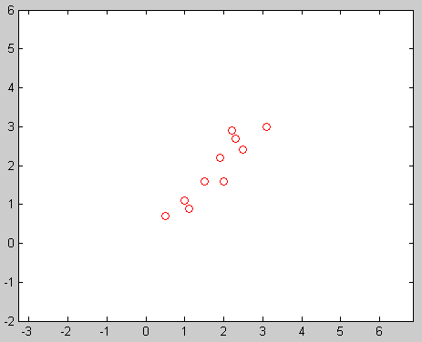
Principal Component Analysis (PCA)
Illustration
How to find?
x , y
(2.5, 2.4) (0.5, 0.7)
(2.2, 2.9)
(1.9, 2.2)
(3.1, 3.0)
(2.3, 2.7)
(2.0, 1.6)
(1.0, 1.1)
(1.5, 1.6)
(1.1, 0.9)
De-correlation!
Along which orientation the data points scatter most?

Slide 40
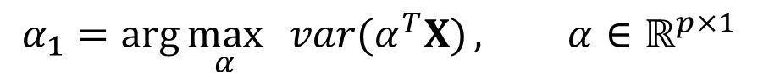
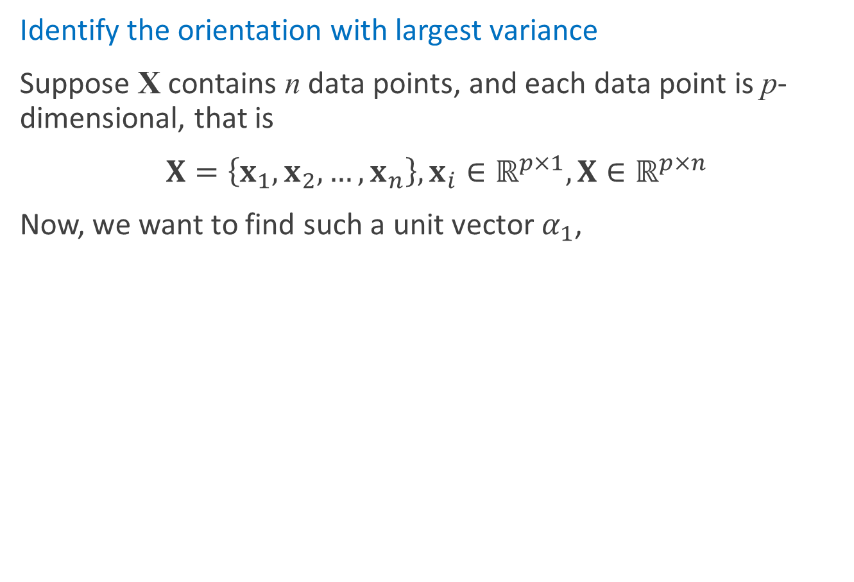
Principal Component Analysis (PCA)
Identify the orientation with largest variance
Suppose X contains n data points, and each data point is p-dimensional, that is
$X=\left\{x_{1},x_{2},…,x_{n}\right\}, x_{i}∈ℝ^{p×1},X∈ℝ^{p×n}$
Now, we want to find such a unit vector $α_{1}$,
$$α_{1}=\arg{\max_{α}{ var(α^{T}X)}, α∈ℝ^{p×1}}$$

Slide 41
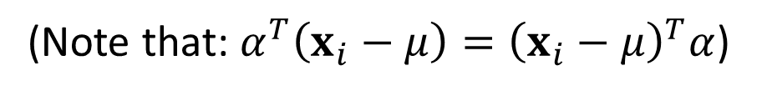
Principal Component Analysis (PCA)
Identify the orientation with largest variance
(Note that: $α^{T}\left(x_{i}−μ\right)={\left(x_{i}−μ\right)}^{T}α$)
where
and is the covariance matrix

Slide 42
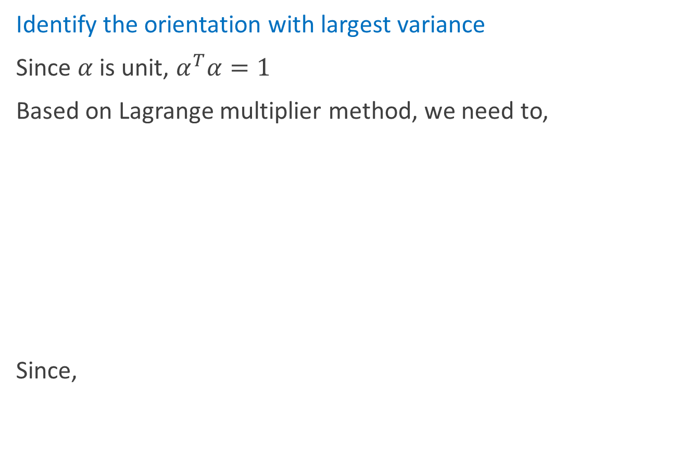
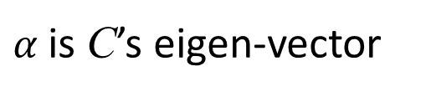
Principal Component Analysis (PCA)
Identify the orientation with largest variance
Since $α$ is unit, $α^{T}α=1$
Based on Lagrange multiplier method, we need to,
Since,
$α$is C’s eigen-vector

Slide 43
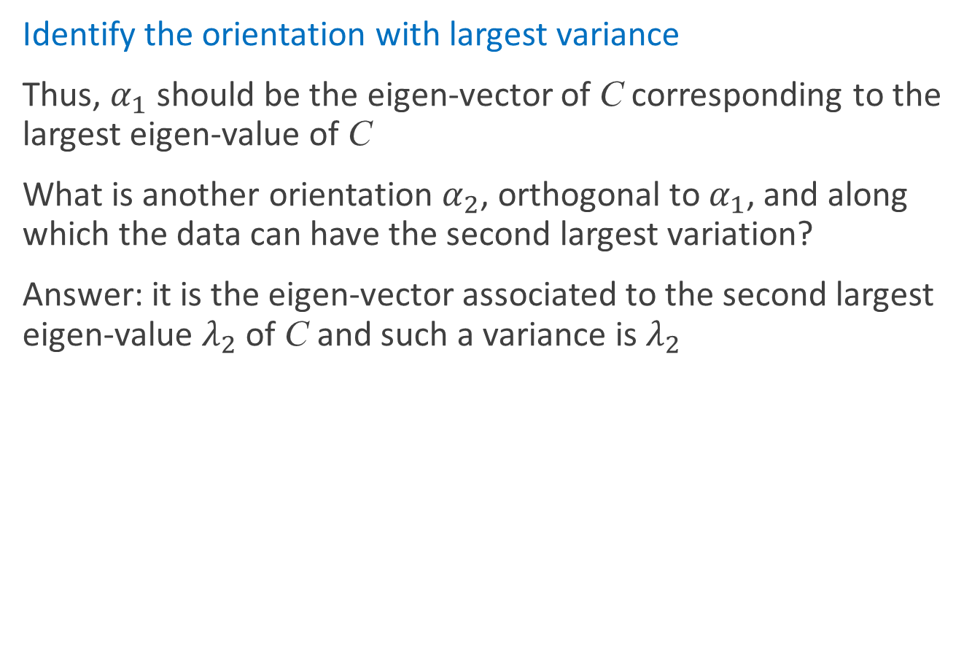
Principal Component Analysis (PCA)
Identify the orientation with largest variance
Thus, $α_{1}$ should be the eigen-vector of C corresponding to the largest eigen-value of C
What is another orientation $α_{2}$, orthogonal to $α_{1}$, and along which the data can have the second largest variation?
Answer: it is the eigen-vector associated to the second largest eigen-value $λ_{2}$ of C and such a variance is $λ_{2}$

Slide 44
Principal Component Analysis (PCA)
Identify the orientation with largest variance
Results: the eigen-vectors of C forms a set of orthogonal basis and they are referred as Principal Components of the original data X
You can consider PCs as a set of orthogonal coordinates. Under such a coordinate system, variables are not correlated.

Slide 45
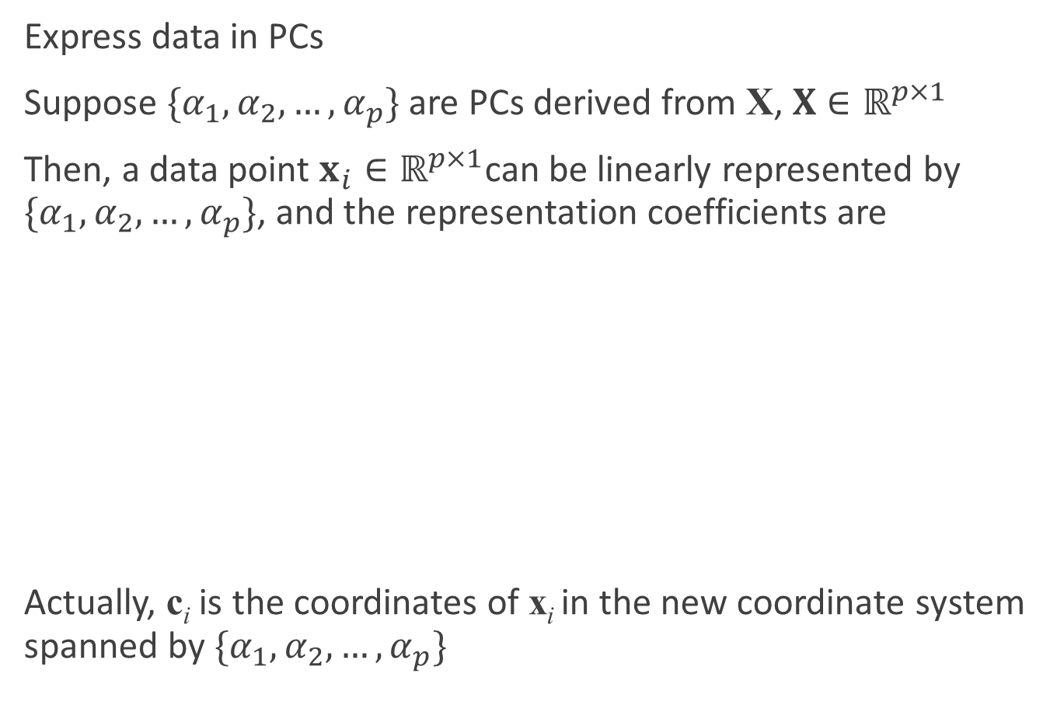
Principal Component Analysis (PCA)
Express data in PCs
Suppose $\{α_{1},α_{2},…,α_{p}\}$ are PCs derived from X, $X∈ℝ^{p×1}$
Then, a data point $x_{i}∈ℝ^{p×1}$can be linearly represented by $\{α_{1},α_{2},…,α_{p}\}$, and the representation coefficients are
Actually, c_{i} is the coordinates of x_{i} in the new coordinate system spanned by $\{α_{1},α_{2},…,α_{p}\}$

Slide 46

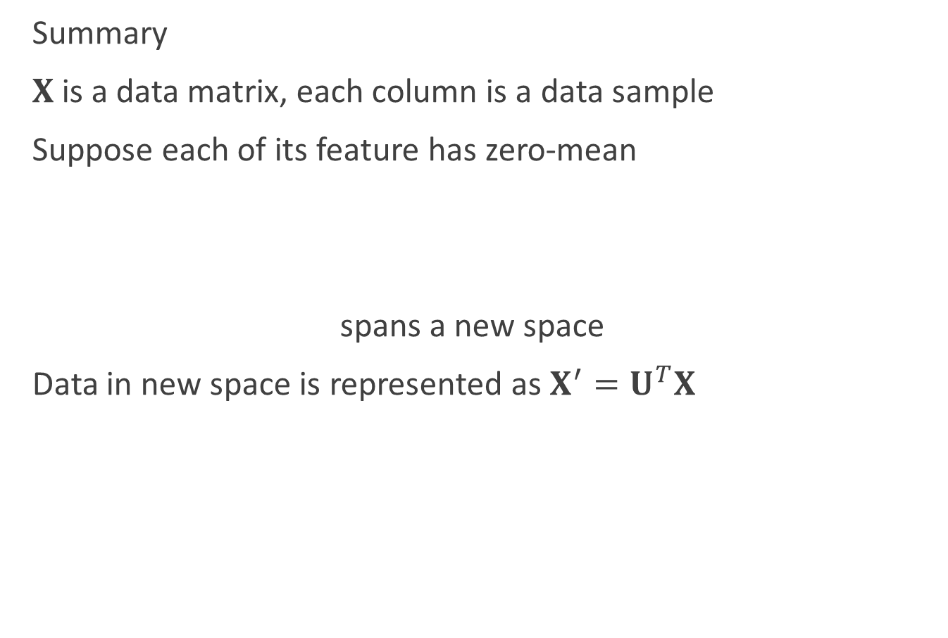
Principal Component Analysis (PCA)
Summary
$X$is a data matrix, each column is a data sample
Suppose each of its feature has zero-mean
spans a new space
Data in new space is represented as $X^{′}=U^{T}X$
In new space, dimensions of data are not correlated

Slide 47
Principal Component Analysis (PCA)
Illustration
x , y
(2.5, 2.4) (0.5, 0.7)
(2.2, 2.9)
(1.9, 2.2)
(3.1, 3.0)
(2.3, 2.7)
(2.0, 1.6)
(1.0, 1.1)
(1.5, 1.6)
(1.1, 0.9)
Eigen-values =
Corresponding eigen-vectors:

Slide 48
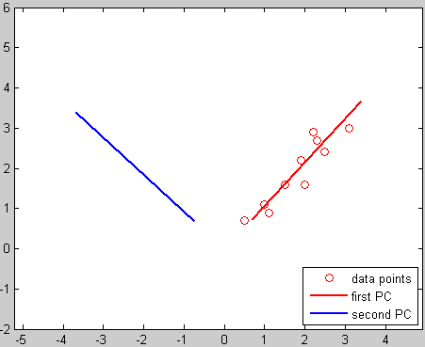
Principal Component Analysis (PCA)
Illustration

Slide 49
Principal Component Analysis (PCA)
Illustration
Coordinates of the data points in the new coordinate system

Slide 50
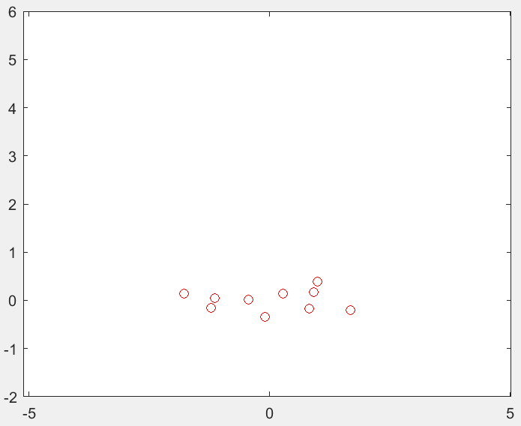
Principal Component Analysis (PCA)
Illustration
Coordinates of the data points in the new coordinate system
Draw newC on the plot
In such a new system, two variables are linearly independent!

Slide 51

Principal Component Analysis (PCA)
Data dimension reduction with PCA
Suppose $X={\left\{x_{i}\right\}}_{i=1}^{n}, x_{i}∈ℝ^{p×1}$, ${\left\{α_{i}\right\}}_{i=1}^{p},α_{i}∈ℝ^{p×1}$ are the PCs
If all of ${\left\{α_{i}\right\}}_{i=1}^{p}$ are used, is still p-dimensional
If only ${\left\{α_{i}\right\}}_{i=1}^{m}, m<p$ are used, $c_{i}$ will be m-dimensional
That is, the dimension of the data is reduced!

Slide 52

Principal Component Analysis (PCA)
Data dimension reduction with PCA
Suppose $X={\left\{x_{i}\right\}}_{i=1}^{n}, x_{i}∈ℝ^{p×1}$,
$U=[u_{1},u_{2},…,u_{p}]$ spans a new space
For dimension reduction, only u₁~u_{m} are used,
$U=\left[u_{1},u_{2},…,u_{m}\right]∈ℝ^{p×m}$
Data in U_{m} ,
$X_{dr}={\left(U_{m}\right)}^{T}X∈ℝ^{m×n}$

Slide 53
Principal Component Analysis (PCA)
Illustration
Coordinates of the data points in the new coordinate system
If only the first PC (corresponds to the largest eigen-value) is remained

Slide 54

Principal Component Analysis (PCA)
Illustration
All PCs are used
Only 1 PC is used
Dimension reduction!

Slide 55
Outline
Introduction
Facial expression recognition
Appearance-based vs. model based
Active appearance model (AAM)
Pre-requisite
Principle component analysis (PCA)
Procrustes analysis
ASM
Delaunay triangulation
AAM

Slide 56
Procrustes analysis
Who is Procrustes?

Slide 57


Procrustes analysis
Problem
Suppose we have two sets of point correspondence pairs $(m_{1},m_{2},…,m_{N})$ and $(n_{1},n_{2},…,n_{N})$
We want find a scale factor s, an orthogonal matrix R and a vector t so that:
$$Σ^{2}=\sum_{i}^{N}{{\left\|m_{i}−\left(sR\left(n_{i}\right)+t\right)\right\|}^{2}}$$

Slide 58

Procrustes analysis
In 2D space:

Slide 59




Procrustes analysis
How to compute s, R, and t?
We assume that there is a similarity transform between point sets ${\left\{m_{i}\right\}}_{i=1}^{N}$ and ${\left\{n_{i}\right\}}_{i=1}^{N}$
Find s, R and t to minimize
Let
Note that
$$Σ^{2}=\sum_{i=1}^{N}{e_{i}^{2}}=\sum_{i=1}^{N}{{\left\|m_{i}−\left(sR\left(n_{i}\right)+t\right)\right\|}^{2}}$$
(1)
$$\overline{m}=\frac{1}{N}\sum_{i=1}^{N}{m_{i}},\overline{n}=\frac{1}{N}\sum_{i=1}^{N}{n_{i}},m_{i}^{′}=m_{i}−\overline{m},n_{i}^{′}=n_{i}−\overline{n}$$
$$\sum_{i=1}^{N}{m_{i}^{′}}=0,\sum_{i=1}^{N}{n_{i}^{′}}=0,$$

Slide 60



Procrustes analysis
Then
$e_{0}=t−\overline{m}+sR(\overline{n})$ is independent from $\{m_{i}^{′},n_{i}^{′}\}$
(1) can be rewritten as:
$$e_{i}=m_{i}−sR\left(n_{i}\right)−t=m_{i}^{′}+\overline{m}−sR\left(n_{i}^{′}+\overline{n}\right)−t$$
$$=m_{i}^{′}+\overline{m}−sR\left(n_{i}^{′}\right)−sR\left(\overline{n}\right)−t$$
$$=m_{i}^{′}−sR\left(n_{i}^{′}\right)−(t−\overline{m}+sR\left(\overline{n}\right)$$
$$=m_{i}^{′}−sR\left(n_{i}^{′}\right)−e_{0}$$
$$Σ^{2}=\sum_{i=1}^{N}{e_{i}^{2}}=\sum_{i=1}^{N}{{\left\|m_{i}^{′}−sR\left(n_{i}^{′}\right)−e_{0}\right\|}^{2}} \\ =\sum_{i=1}^{N}{{\left\|m_{i}^{′}−sR\left(n_{i}^{′}\right)\right\|}^{2}}−2e_{0}⋅\sum_{i=1}^{N}{\left(m_{i}^{′}−sR\left(n_{i}^{′}\right)\right)}+Ne_{0}^{2}$$
$$=\sum_{i=1}^{N}{{\left\|m_{i}^{′}−sR\left(n_{i}^{′}\right)\right\|}^{2}}−2e_{0}⋅\sum_{i=1}^{N}{\left(m_{i}^{′}\right)}+2e_{0}⋅\sum_{i=1}^{N}{\left(sR(n_{i}^{′})\right)}+Ne_{0}^{2}$$
$$=\sum_{i=1}^{N}{{\left\|m_{i}^{′}−sR\left(n_{i}^{′}\right)\right\|}^{2}}+Ne_{0}^{2}$$

Slide 61



Procrustes analysis
$$Σ^{2}=\sum_{i=1}^{N}{{\left\|m_{i}^{′}−sR\left(n_{i}^{′}\right)\right\|}^{2}}+Ne_{0}^{2}$$
$e_{0}^{2}=0⟺t=\overline{m}−sR(\overline{n})$
Variables are separated and can be minimized separately.
If we have s and R, t can be determined

Slide 62


Procrustes analysis
Then the problem simplifies to: how to minimize
We revise the error item as a symmetrical one:
$$Σ^{2}=\sum_{i=1}^{N}{{\left\|m_{i}^{′}−sR\left(n_{i}^{′}\right)\right\|}^{2}}$$
$$\frac{1}{s}Σ^{2}=\sum_{i=1}^{N}{{\left\|{\frac{1}{\sqrt{s}}m}_{i}^{′}−\sqrt{s}R\left(n_{i}^{′}\right)\right\|}^{2}}$$
$$=\frac{1}{s}\sum_{i=1}^{N}{{\left\|m_{i}^{′}\right\|}^{2}}−2\sum_{i=1}^{N}{\left(m_{i}^{′}⋅R\left(n_{i}^{′}\right)\right)}+s\sum_{i=1}^{N}{{\left\|R(n_{i}^{′})\right\|}^{2}}$$
$$=\frac{1}{s}\sum_{i=1}^{N}{{\left\|m_{i}^{′}\right\|}^{2}}−2\sum_{i=1}^{N}{\left(m_{i}^{′}⋅R\left(n_{i}^{′}\right)\right)}+s\sum_{i=1}^{N}{{\left\|n_{i}^{′}\right\|}^{2}}$$

Slide 63


Procrustes analysis
$$\frac{1}{s}Σ^{2}=\frac{1}{s}\sum_{i=1}^{N}{{\left\|m_{i}^{′}\right\|}^{2}}−2\sum_{i=1}^{N}{\left(m_{i}^{′}⋅R\left(n_{i}^{′}\right)\right)}+s\sum_{i=1}^{N}{{\left\|n_{i}^{′}\right\|}^{2}}$$
$$\frac{1}{s}Σ^{2}=\frac{1}{s}P−2D+sQ={\left(\sqrt{s}\sqrt{Q}−\frac{1}{\sqrt{s}}\sqrt{P}\right)}^{2}+2(\sqrt{PQ}−D)$$
Thus
P
D
Q
Variables are separated!
$${\left(\sqrt{s}\sqrt{Q}−\frac{1}{\sqrt{s}}\sqrt{P}\right)}^{2}=0⇒s=\sqrt{\frac{P}{Q}}=\sqrt{\frac{\sum_{i=1}^{N}{{\left\|m_{i}^{′}\right\|}^{2}}}{\sum_{i=1}^{N}{{\left\|n_{i}^{′}\right\|}^{2}}}}$$
Determined!

Slide 64



Procrustes analysis
Then the problem simplifies to: how to maximize
Now we are looking for an orthogonal matrix R to maximize the trace of RH.
$$D=\sum_{i=1}^{N}{\left(m_{i}^{′}⋅R\left(n_{i}^{′}\right)\right)}$$
Note that: D is a real number
$$D=\sum_{i=1}^{N}{\left(m_{i}^{′}⋅R\left(n_{i}^{′}\right)\right)}=\sum_{i=1}^{N}{{\left(m_{i}^{′}\right)}^{T}R\left(n_{i}^{′}\right)}=trace\left(\sum_{i=1}^{N}{Rn_{i}^{′}{{(m}_{i}^{′})}^{T}}\right)$$
$$=trace\left(RH\right)$$
$$ℋ≜trace\left(RH\right)$$
$$trace\left(AB\right)=trace(BA)$$

Slide 65


Procrustes analysis
Lemma For any positive semi-definite matrix C and any orthogonal matrix B:
$trace\left(C\right)≥trace(BC)$
Proof
From the positive definite property of C, $∃A,C=AA^{T}$
where A is a non-singular matrix.
Let $a_{i}$ be the ith column of A. Then
$$trace\left(BAA^{T}\right)=trace\left(A^{T}BA\right)=\sum_{i}{a_{i}^{T}(Ba_{i})}$$

Slide 66



Procrustes analysis
According to Schwarz inequality: $\left|\left\langle x,y\right\rangle \right|≤\left\|x\right\|\left\|y\right\|$
Hence
That is
proof end
$$a_{i}^{T}\left(Ba_{i}\right)≤\left\|a_{i}^{T}\right\|\left\|Ba_{i}\right\|=\sqrt{\left(a_{i}^{T}a_{i}\right)\left(a_{i}^{T}B^{T}Ba_{i}\right)}=a_{i}^{T}a_{i}$$
$$trace\left(BAA^{T}\right)≤trace\left(a_{i}^{T}a_{i}\right)=trace(AA^{T})$$
$$trace\left(BC\right)≤trace(C)$$

Slide 67



Procrustes analysis
Consider the SVD of H
According to the property of SVD, U and V are orthogonal matrices, and Λ is a diagonal matrix with nonnegative elements
Now let $X=VU^{T}$
We have $XH={VU}^{T}UΛV^{T}=VΛV^{T}$ which is positive semi-definite.
Thus, from the lemma, we know: for any orthogonal matrix B
$trace\left(XH\right)≥trace\left(BXH\right)$
$trace\left(XH\right)≥trace(ΨH)$
$$H=\sum_{i=1}^{N}{n_{i}^{′}{{(m}_{i}^{′})}^{T}}=UΛV^{T}$$
Note that: X is orthogonal.
for any orthogonal matrix $Ψ$

Slide 68


Procrustes analysis
It’s time to go back to our objective now… R should be X
Now, s, R and t are all determined
$$H=\sum_{i=1}^{N}{n_{i}^{′}{{(m}_{i}^{′})}^{T}}=UΛV^{T}$$
$$R=VU^{T} s=\sqrt{\frac{\sum_{i=1}^{N}{{\left\|m_{i}^{′}\right\|}^{2}}}{\sum_{i=1}^{N}{{\left\|n_{i}^{′}\right\|}^{2}}}} t=\overline{m}−sR(\overline{n})$$

Slide 69


Procrustes analysis
Problem Given two configuration matrices X and Y with the same dimensions, find rotation and translation that would bring Y as close as possible to X
Solution
Find the centroids (mean values of columns) of X and Y. Call them $\overline{x}$ and $\overline{y}$.
Remove from each column corresponding mean. Call the new matrices $X_{new}$ and $Y_{new}$
Find $Y_{new}^{T}X_{new}$. Find the SVD of this matrix $Y_{new}^{T}X_{new}=UΛV^{T}$
Find the rotation matrix $R=VU^{T}$. Find scale factor
Find the translation vector $t=\overline{x}−sR\overline{y}$
$$s=\sqrt{\frac{\sum_{i=1}^{N}{{\left\|m_{i}^{′}\right\|}^{2}}}{\sum_{i=1}^{N}{{\left\|n_{i}^{′}\right\|}^{2}}}}$$

Slide 70


Some modifications
Sometimes it is necessary to weight some variables down and others up. In these cases Procrustes analysis can be performed using weights. We want to minimize the function:
This modification can be taken into account if we find SVD of $Y^{T}WX$ instead of $Y^{T}X$
$$M^{2}=tr(\left(X−AY\right){W\left(X−AY\right)}^{T})$$

Slide 71
Outline
Introduction
Facial expression recognition
Appearance-based vs. model based
Active appearance model (AAM)
Pre-requisite
Principle component analysis (PCA)
Procrustes analysis
ASM
Delaunay triangulation
AAM

Slide 72




Active shape model (ASM): training
Collect training samples
30 neutral faces
30 smile faces

Slide 73



ASM: training
Add landmarks
26 points each face
Training set: $X=\left[x_{1},x_{2},…,x_{N}\right]$

Slide 74


ASM: training
Phase 1: Align training faces using Procrustes analysis
Transform $x_{i}$ to $x_{j}$: Rotation ($R_{i}$), Scale ($s_{i}$), Transformation ($t_{i}$)
$$\min{{\left\|Z_{i}\right\|}^{2}}$$
$$Z_{i}=x_{j}−(sR\left(x_{i}\right)−t_{i})$$
Consider a weight matrix W
$D_{kl}$ represents the distance between the $x_{ik}$ and $x_{il}$ in one image and $V_{D_{kl}}$ represents the variance of $D_{kl}$ in different images
$m$ is the dimension of $x_{i}$
$$w_{k}={\left(\sum_{l=1}^{m}{V_{D_{kl}}}\right)}^{−1} W=\left(\begin{matrix}w_{1} & & \\ & ⋱ & \\ & & w_{m}\end{matrix}\right)$$
Notes:
https://zybuluo.com/chenbiaolong/note/104505

Slide 75


ASM: training
We want to solve the optimization problem:
Solution
Find the centroids (mean values of columns) of $x_{i}$ and $x_{j}$.
Remove from each column corresponding mean.
Find the SVD of this matrix $x_{i_new}Wx_{j_new}^{T}=UΛV^{T}$
Find the rotation matrix $A=VU^{T}$. Find the scale factor and translation vector as shown in page 69
$$E_{i}=\min{Z_{i}WZ_{i}^{T}}$$

Slide 76

ASM: training
Phase 1: Align training faces using Procrustes analysis
Steps
Align the other faces with the first face
Compute the mean face
Align training faces with the mean face
Repeat step 2 and 3 until the discrepancies between training faces and the mean face won’t change
$$\overline{x}=\sum_{i=1}^{N}{x_{i}}$$

Slide 77











ASM: training
Faces after alignment
ession recognition

Slide 78





ASM: training
Phase 2: Construct models of faces
Compute mean face
Calculate covariance matrix
Find its eigenvalues $(λ_{1},λ_{2},…,λ_{m})$ and eigenvectors $P=(p_{1},p_{2},…,p_{m})$
Choose the first t largest eigenvalues
Usually $f_{v} = 0.98$
$$\overline{x}=\sum_{i=1}^{N}{x_{i}}$$
$$S=\frac{1}{N}\sum_{i=1}^{N}{\left(x_{i}−\overline{x}\right){\left(x_{i}−\overline{x}\right)}^{T}}$$
$$\sum_{i=1}^{t}{λ_{i}}≥f_{v}V_{t},V_{t}=\sum_{i=1}^{m}{λ_{i}}$$
Dimension reduction: 26*2$→$27

Slide 79


ASM: training
We can approximate a training face x
$x≈\overline{x}+Pb$
$b=P^{T}(x−\overline{x})$
$b_{i}$ is called the i-th mode of the model
constraint: $\left|b_{i}\right|≤3\sqrt{λ_{i}}$

Slide 80

ASM: training
Effect of varying the first three shape parameters in turn between ±3 s.d. (standard deviation) from the mean value
-3 s.d. origin +3 s.d. -3 s.d. origin +3 s.d.
Facial expression recognition

Slide 81


ASM: test
Steps
Examine a region of a new image around each point $x_{i}$ to find the best nearby match for the point $x_{i}^{′}$
Update the parameters $(t, s, R, b)$to best fit the new found points $x_{i}^{′}$
Apply constraints to the parameters, $b$, to ensure plausible shapes (e.g. limit so $\left|b_{i}\right|≤3\sqrt{λ_{i}}$)
Repeat until convergence
Q1: How to find corresponding points in a new image?

Slide 82


ASM: test
Find the initial corresponding points
Detect face using Viola-Jones face detector
Estimate positions of eyes centers, nose center, and mouse center
Align the corresponding positions on the mean face to the estimated positions of eyes centers, nose center, and mouse center ($s_{init}$, $R_{init}$, $t_{init}$) on the new face
$$x_{init}=s_{init}R_{init}\overline{x}+t_{init}$$
recognition

Slide 83


ASM: test
Construct local features for each point in the training samples
For a given point, we sample along a profile k pixels either side of the model point in the ith training image.
Instead of sampling absolute grey-level values, we sample derivatives and put them in a vector $g_{i}$
Normalize the sample:
$$g_{i}=\frac{g_{i}}{\sum_{j}{g_{ij}}}$$
point i-1
point i
2k+1
pixels
point i+1

Slide 84


ASM: test
For training image 1~N, we can get a set of normalized samples $\{g_{1},g_{2},…,g_{N}\}$ for point $i$
We assume that these $g_{i}$ are distributed as a multivariate Gaussian, and estimate their mean $\overline{g_{i}}$ and covariance $S_{g_{i}}$.
This gives a statistical model for the grey-level profile about the point $i$
Given a new sample $g_{s}$, the distance of $g_{s}$ to $\overline{g_{i}}$ can be computed using the Mahalanobis distance
$$d\left(g_{s},\overline{g_{i}}\right)={\left(g_{s}−\overline{g_{i}}\right)}^{T}S_{g_{i}}^{−1}(g_{s}−\overline{g_{i}})$$

Slide 85


ASM: test
During search we sample a profile m pixels from either side of each initial point ($m>k$) on the new face.
point i
dx_{i}
2m+1
pixels
point i+1
$$d_{best}=\min_{g_{s}}{d\left(g_{s},\overline{g_{i}}\right)={\left(g_{s}−\overline{g_{i}}\right)}^{T}S_{g_{i}}^{−1}(g_{s}−\overline{g_{i}}) }$$

Slide 86

ASM: test
Some constraints on $dx_{i}$
$\left|dx_{i}\right|=0 if\left|d_{best}\right|≤δ$
$\left|dx_{i}\right|=0. 5d_{best} ifδ≤\left|d_{best}\right|≤d_{max}$
$\left|dx_{i}\right|=0. 5d_{max} if\left|d_{best}\right|>d_{max}$

Slide 87


ASM: test
Apply one iteration of ASM algorithm
Examine a region of a new image around each point $x_{i}$ to find the best nearby match for the point $x_{i}^{′}$
$$x_{i}^{′}=x_{i}+dx_{i}$$
Update the parameters $(t, s, R, b)$to best fit the new found points $x_{i}^{′}$
Apply constraints to the parameters, $b$, to ensure plausible shapes (e.g. limit so $\left|b_{i}\right|≤3\sqrt{λ_{i}}$)
Repeat until convergence
Q1: How to find corresponding points in a new image? (Solved!)
Q2: How to find $t$, $s$, $R$, and $b$ for $x_{i}^{′}$?

Slide 88

ASM: test
Suppose we want to match a model $x$ to a new set of image points $y$
We wish to find $(t, s, R, b)$ that can minimize ${\left|y−sR\left(x\right)−t\right|}^{2}$
i.e.
$$\min{{\left|y−sR\left(x\right)−t\right|}^{2}≈{\left|y−sR\left(\overline{x}+Pb \right)−t\right|}^{2}}$$

Slide 89

ASM: test
A simple iterative approach to achieving the minimum
Steps
Initialize the shape parameters, $b$, to zero (the mean shape).
Generate the model point positions using $x=\overline{x}+Pb$
Find the pose parameters $(s, R,t)$which best align the model points $x$ to the current found points $y$
$$\min{{\left|y−sR\left(x\right)−t\right|}^{2}}$$
Project $y$ into the model co-ordinate frame by inverting the transformation $y^{′}=R^{−1}(y+t)/s$
Project $y$ into the tangent plane to 𝐱 by scaling $y^{′′}=y^{′}/(y^{′}⋅\overline{x})$
Update the model parameters to match to $y′′$: $b=P^{T}(y^{′′}−\overline{x})$
If not converged, return to step 2.

Slide 90

ASM: test
Apply one iteration of ASM algorithm
Examine a region of the image around each point $x_{i}$ to find the best nearby match for the point $x_{i}^{′}$
$$x_{i}^{′}=x_{i}+dx_{i}$$
Update the parameters $(t, s, R, b)$to best fit the new found points $x_{i}^{′}$ using the algorithm in page 89
Apply constraints to the parameters, $b$, to ensure plausible shapes (e.g. limit so $\left|b_{i}\right|≤3\sqrt{λ_{i}}$)
Repeat until convergence
Q2: How to find $t$, $s$, $R$, and $b$ for $x_{i}^{′}$? (Solved!)

Slide 91




Examples
Initial Position
After 1 iteration
After 2 iterations
Convergence

Slide 92

Examples
Brain Search
Notes:
https://personalpages.manchester.ac.uk/staff/timothy.f.cootes/Models/brain_search.html
https://personalpages.manchester.ac.uk/staff/timothy.f.cootes/software/am_tools_doc/index.html

Slide 93

ASM: test
So now we have a vector of $b$ for the new face
Classify facial expression using $b$

Slide 94

Classification
Training
Compute b for each training faces
Training a classifier (e.g. SVM, Neural Network) using $\{b_{1},b_{2},…,b_{N}\}$and the corresponding labels
Test
Using the trained classifier to classify a new mode vector $b_{new}$ of a new face

Slide 95
Outline
Introduction
Facial expression recognition
Appearance-based vs. model based
Active appearance model (AAM)
Pre-requisite
Principle component analysis (PCA)
Procrustes analysis
ASM
Delaunay triangulation
AAM

Slide 96
Delaunay triangulation
Terrains by interpolation
To build a model of the terrain surface, we can start with a number of sample points where we know the height.

Slide 97


Delaunay triangulation
How do we interpolate the height at other points?
Height $f(p)$ defined at each point $p$ in $P$
How can we most naturally approximate height of points not in $P$?
Let $f(p)$ = height of nearest point for points not in A
Does not look natural

Slide 98



Delaunay triangulation
Better option: triangulation
Determine a triangulation of $P$ in $R^{2}$, then raise points to desired height
Triangulation: planar subdivision whose bounded faces are triangles with vertices from $P$

Slide 99


Delaunay triangulation
Formal definition
Let $P= \{p_{1},…,p_{n}\}$be a point set.
Maximal planar subdivision: a subdivision S such that no edge connecting two vertices can be added to S without destroying its planarity
A triangulation of P is a maximal planar subdivision with vertex set P.

Slide 100

Delaunay triangulation
Triangulation is made of triangles
Outer polygon must be convex hull
Internal faces must be triangles, otherwise they could be triangulated further

Slide 101
Delaunay triangulation
For P consisting of n points, all triangulations contain
2n-2-k triangles
3n-3-k edges
n= number of points in P
k= number of points on convex hull of P

Slide 102

Delaunay triangulation
But which triangulation?

Slide 103

Delaunay triangulation
Some triangulations are “better” than others
Avoid skinny triangles, i.e. maximize minimum angle of triangulation

Slide 104

Delaunay triangulation
Let 𝒯 be a triangulation of P with m triangles. Its angle vector is $A(𝒯) = (α_{1},…,α_{3m})$ where $α_{1},…,α_{3m}$ are the angles of 𝒯 sorted by increasing value.
Let 𝒯′ be another triangulation of P. $A(𝒯)$is larger then $A(𝒯′)$iff there exists an i such that $a_{j}= a_{j}^{′}$ for all j < i and $a_{i}>a_{i}^{′}$
𝒯 is angle optimal if $A(𝒯)>A(𝒯′)$for all triangulations 𝒯′ of P

Slide 105

Delaunay triangulation
If the two triangles form a convex quadrilateral, we could have an alternative triangulation by performing an edge flip on their shared edge.

Slide 106


Delaunay triangulation
The edge $e=\overline{P_{i}P_{j}}$ is illegal if
$\min_{1≤i≤6}α_{i}≤\min_{1≤i≤6}α_{i}^{′}$
Only difference between 𝒯 containing $e$ and $𝒯^{′}$ with $e$ flipped are the six angles of the quadrilateral.
Flipping an illegal edge increases the angle vector

Slide 107

Delaunay triangulation
If triangulation 𝒯 contains an illegal edge e, we can make $A(𝒯)$ larger by flipping e.
In this case, 𝒯 is an illegal triangulation.

Slide 108


Delaunay triangulation
We can use Thales’ Theorem to test if an edge is legal without calculating angles
Theorem Let C be a circle, ℓ a line intersecting C in points a and b, and p, q, r, s points lying on the same side of ℓ. Suppose that p, q lie on C, r lies inside C, and s lies outside C. Then
$∡arb > ∡apb = ∡aqb > ∡asb$

Slide 109


Delaunay triangulation
If $p_{i}$, $p_{j}$, $p_{k}$, $p_{l}$ form a convex quadrilateral and do not lie on a common circle, exactly one of $p_{i}p_{j}$ and $p_{k}p_{l}$ is an illegal edge.
Lemma The edge $\overline{p_{i}p_{j}}$ is illegal iff $p_{l}$ lies in the interior of the circle C.

Slide 110
Delaunay triangulation
A legal triangulation is a triangulation that does not contain any illegal edge.
Compute Legal Triangulations
Compute a triangulation of input points P.
Flip illegal edges of this triangulation until all edges are legal.
Algorithm terminates because there is a finite number of triangulations.
Too slow to be interesting …

Slide 111
Delaunay triangulation
Before we can understand an interesting solution to the terrain problem, we need to understand Delaunay Graphs.
Delaunay Graph of a set of points P is the dual graph of the Voronoi diagram of P

Slide 112

Delaunay triangulation
Let P be a set of n points in the plane
The Voronoi diagram Vor$(P)$ is the subdivision of the plane into Voronoi cells V$(p)$ for all $p∈P$
Let G be the dual graph of Vor$(P)$
The Delaunay graph DG$(P)$ is the straight line embedding of G

Slide 113



Delaunay triangulation
CalculateVor$(P)$
Place one vertex in each site of theVor$(P)$
If two sites $s_{i}$ and $s_{j}$ share an edge ($s_{i}$ and $s_{j}$ are adjacent), create an arc between $v_{i}$ and $v_{j}$, the vertices located in sites $s_{i}$ and $s_{j}$

Slide 114


Delaunay triangulation
Finally, straighten the arcs into line segments. The resultant graph is DG$(P)$.

Slide 115


Delaunay triangulation
Properties of Delaunay Graphs
No two edges cross; DG$(P)$ is a planar graph.

Slide 116
Delaunay triangulation
Some sets of more than 3 points of Delaunay graph may lie on the same circle.
These points form empty convex polygons, which can be triangulated.
Delaunay Triangulation is a triangulation obtained by adding 0 or more edges to the Delaunay Graph.

Slide 117

Delaunay triangulation
From the properties of Voronoi Diagrams…
Three points $p_{i}$, $p_{j}$, $p_{k}∈P$ are vertices of the same face of the DG$(P)$ iff the circle through $p_{i}$, $p_{j}$, $p_{k}$ contains no point of P on its interior.

Slide 118

Delaunay triangulation
From the properties of Voronoi Diagrams…
Two points $p_{i}$, $p_{j}∈P$ form an edge of DG$(P)$ iff there is a closed disc C that contains $p_{i}$, $p_{j}$ on its boundary and does not contain any other point of P.

Slide 119

Delaunay triangulation
From the previous two properties…
A triangulation 𝒯 of P is a DT$(P)$ iff the circumcircle of any triangle of 𝒯 does not contain a point of P in its interior.

Slide 120


Delaunay triangulation
A triangulation 𝒯 of P is legal iff 𝒯 is a DT$(P)$.
DT → Legal: Empty circle property and Thale’s Theorem implies that all DT are legal
Legal → DT
Let P be a set of points in the plane. Any angle-optimal triangulation of P is a Delaunay triangulation of P.
Furthermore, any Delaunay triangulation of P maximizes the minimum angle over all triangulations of P.

Slide 121
Delaunay triangulation
Therefore, the problem of finding a triangulation that maximizes the minimum angle is reduced to the problem of finding a Delaunay Triangulation.
So how do we find the Delaunay Triangulation?

Slide 122

Delaunay triangulation
How do we compute DT$(P)$?
We could compute Vor$(P)$ then dualize into DT$(P)$.
Instead, we will compute DT$(P)$ using a randomized incremental method.

Slide 123

Delaunay triangulation
Incremental method
Initialize triangulation T with a “big enough” helper bounding triangle that contains all points P.
Randomly choose a point $p_{r}$ from P.
Find the triangle $Δ$that $p_{r}$ lies in.
Subdivide $Δ$ into smaller triangles that have $p_{r}$ as a vertex.
Flip edges until all edges are legal.
Repeat steps 2-5 until all points have been added to T.

Slide 124
Delaunay triangulation
In matlab, try delaunay(X,Y) function

Slide 125
Outline
Introduction
Facial expression recognition
Appearance-based vs. model based
Active appearance model (AAM)
Pre-requisite
Principle component analysis (PCA)
Procrustes analysis
ASM
Delaunay triangulation
AAM

Slide 126

Active Appearance Model (AAM)
Steps of constructing AAM
Apply triangulation algorithm on the training faces;

Slide 127
Active Appearance Model (AAM)
Steps of constructing AAM
Warp the training face to the mean face by matching the corresponding triangles;

Slide 128


Active Appearance Model (AAM)
Steps of constructing AAM
Sample the grey level information $g_{im}$ from the shape-normalized image over the region covered by the mean face
To minimize the effect of global lighting variation, normalize the faces
$$g=\frac{g_{im}−β1}{α}$$
$$α=g_{im}⋅\overline{g}; β=\frac{g_{im}⋅1}{n}$$

Slide 129

Active Appearance Model (AAM)
Steps of constructing AAM
Apply PCA to the normalized data
$$g=\overline{g}+P_{g}b_{g}$$

Slide 130



AAM
Appearance vector:
Apply a further PCA
c is a vector of appearance parameters
We can express the face as functions of c
$$b=\left(\begin{matrix}W_{s}b_{s} \\ b_{g}\end{matrix}\right)=\left(\begin{matrix}W_{s}P_{s}^{T}\left(x−\overline{x}\right) \\ P_{g}^{T}\left(g−\overline{g}\right)\end{matrix}\right)$$
$$b=Qc$$
$$x=\overline{x}+P_{s}W_{s}Q_{s}c$$
$$g=\overline{g}+P_{g}Q_{g}c$$
$$Q=\left(\begin{matrix}Q_{s} \\ Q_{g}\end{matrix}\right)$$

